Slide 1
Car Insurance claim
Presented by: XXXX

Slide 2
Part -1
Exploratory analysis and Visualization of Data

Slide 3
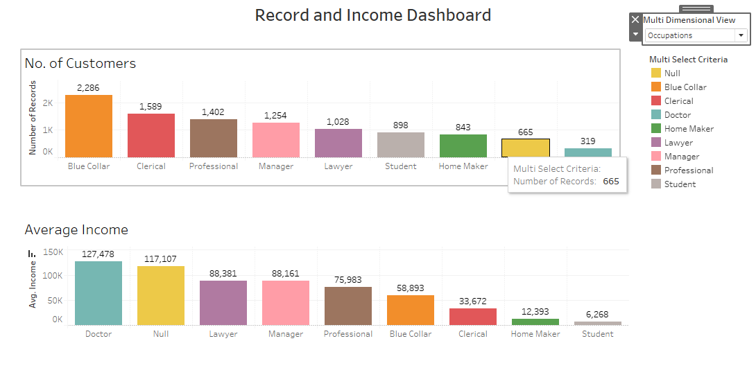
Record and Income Dashboard
Insight – Customers with education PhD having the highest average income and Customers with occupation Blue Collar have the highest count.

Slide 4
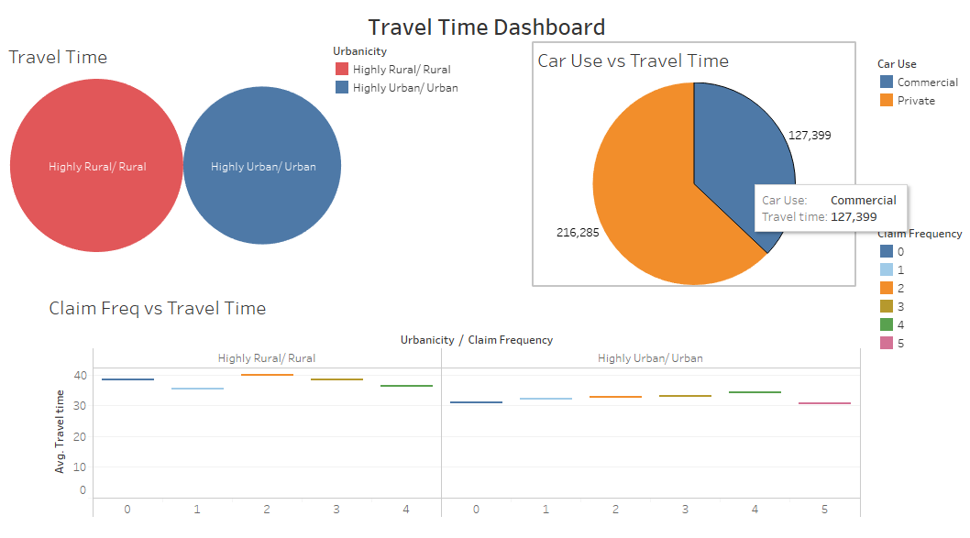
Travel Time Dashboard
Insight – Time taken by private vehicles is more than the commercial ones. Also, average travel time in rural area is more in comparison with the urban one.

Slide 5
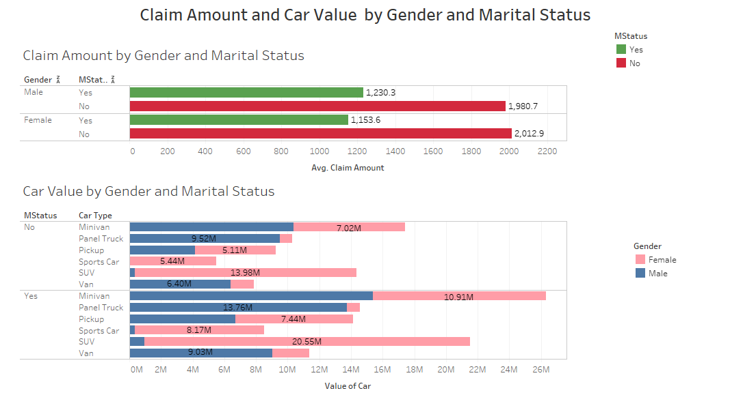
Claim Amount and Car Value Dashboard
Insight – For Claim by gender and Marital status, average claim amount is claimed by the unmarried females. For Car value by gender and marital status – Minivan is having the highest car value among married females.

Slide 6
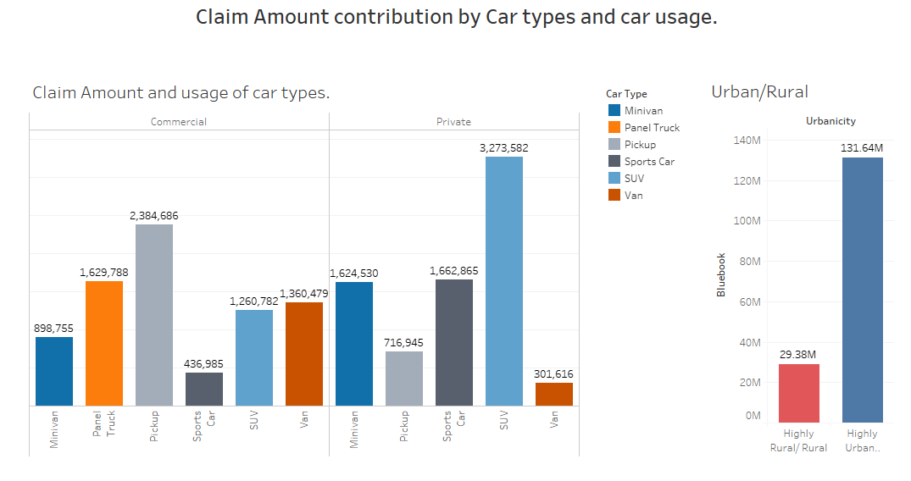
Claim amount distribution by Car Type Usage in Rural and Urban
Insight – Among Private car use, SUV holds the highest claim and in Commercial Pickup holds the highest claim. Among rural/ Highly-urban/Urban, Highly-urban/Urban is having the highest claims amount.

Slide 7
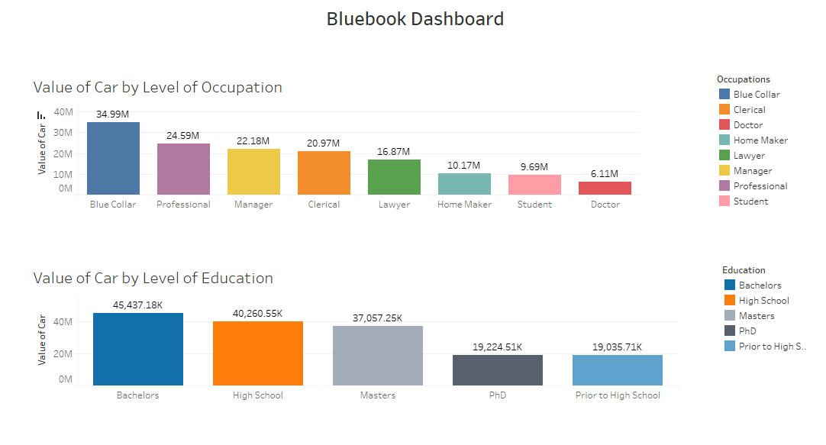
Bluebook dashboard
Insights – For occupation, Value of car is highest among the Blue Collars and among education, Bachelors having the highest value.

Slide 8
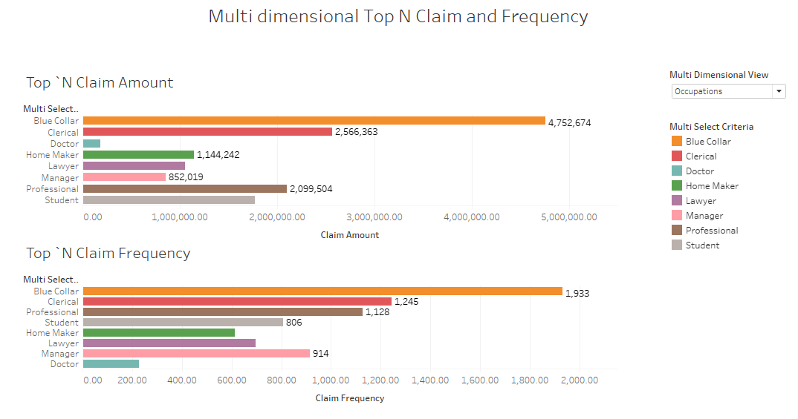
Multi-dimensional Top N Claim and Frequency dashboard
Insight – Blue Collar holds the highest Claim amount and claim frequency, also PhD holder’s claim amount and their frequency is minimum.

Slide 9
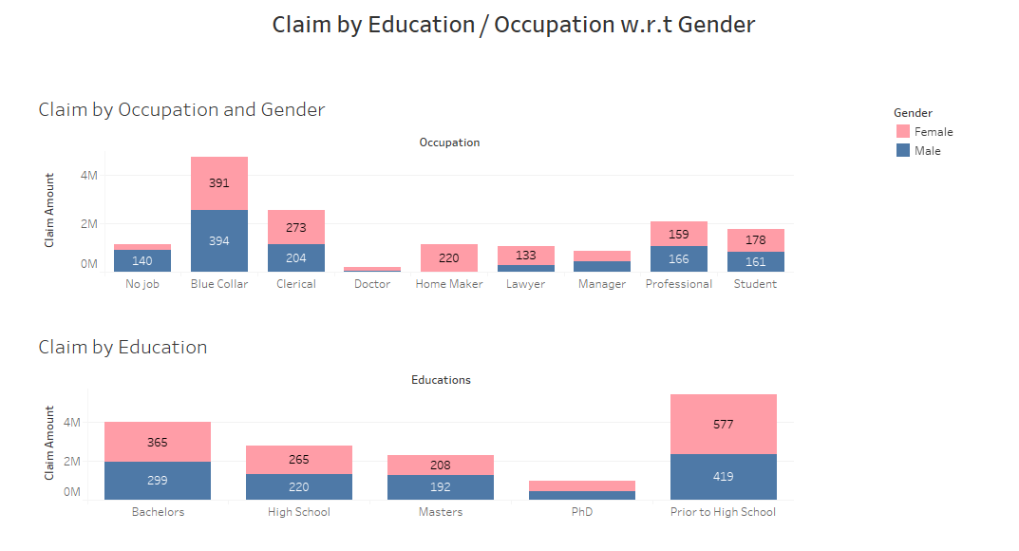
Claim by Education/Occupation with respect to Gender
Insight – Among Blue collars highest claim frequency and the claim amount is highest among the males and female bachelors have the highest frequency.

Slide 10
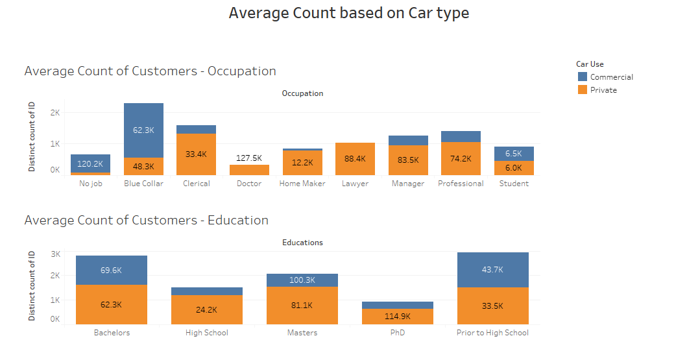
Average Count dashboard
Insight – Blue Collar (Occupation) and Bachelors (Education) have the highest customer count.

Slide 11
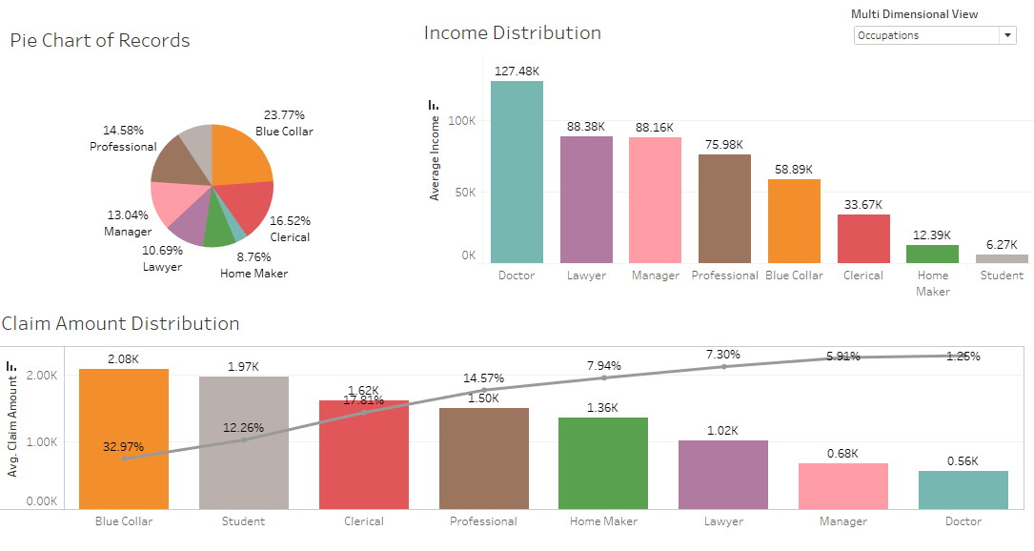
Distribution Dashboard
Insight- Education: Prior to high school have the highest customer count, PhD having the highest income distribution, and the highest claim amount is claimed by High school customers.
Occupation: Blue Collar have the highest customer count, Doctors having the highest income distribution, and the highest claim amount is claimed by Blue Collar customers.

Slide 12
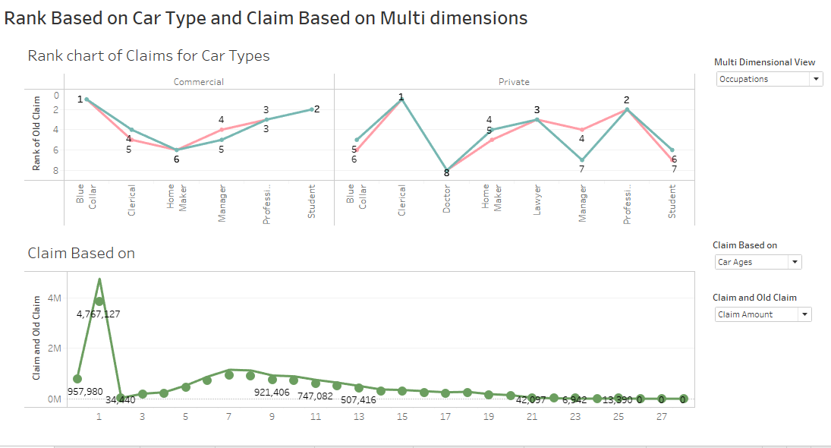
Rank and Claim Dashboard
Insight- Among Car types, Commercial, Pickup tops the ranking of claims and among Private it’s SUV. Customer with 1 year of Car age have the highest claims.

Slide 13
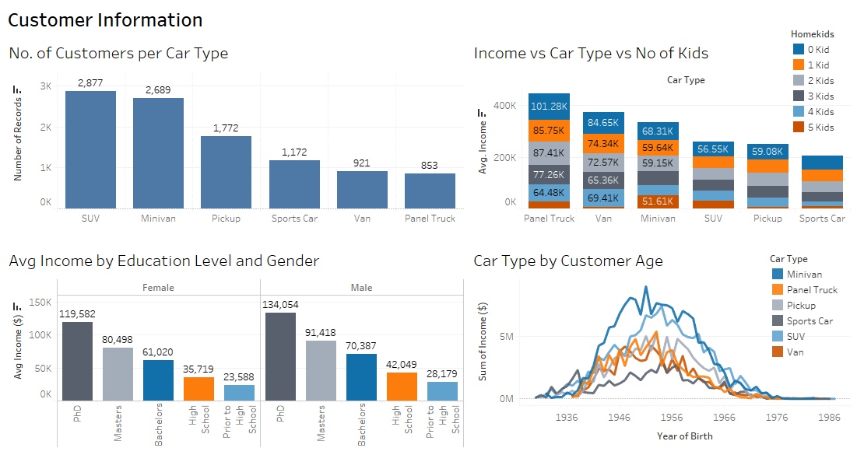
Customer Info Dashboard
Insight – SUV users are the highest and Panel truck users are minimum. Customers with Panel Truck and 0 kids have the maximum average income and Customers with Sports Car and 5 kids have the minimum average income. Average Income of PhD holder’s among both gender is the highest and Prior to high school have the lowest average income. Customers with Minivan and year of Birth 1951 holds the maximum income.

Slide 14
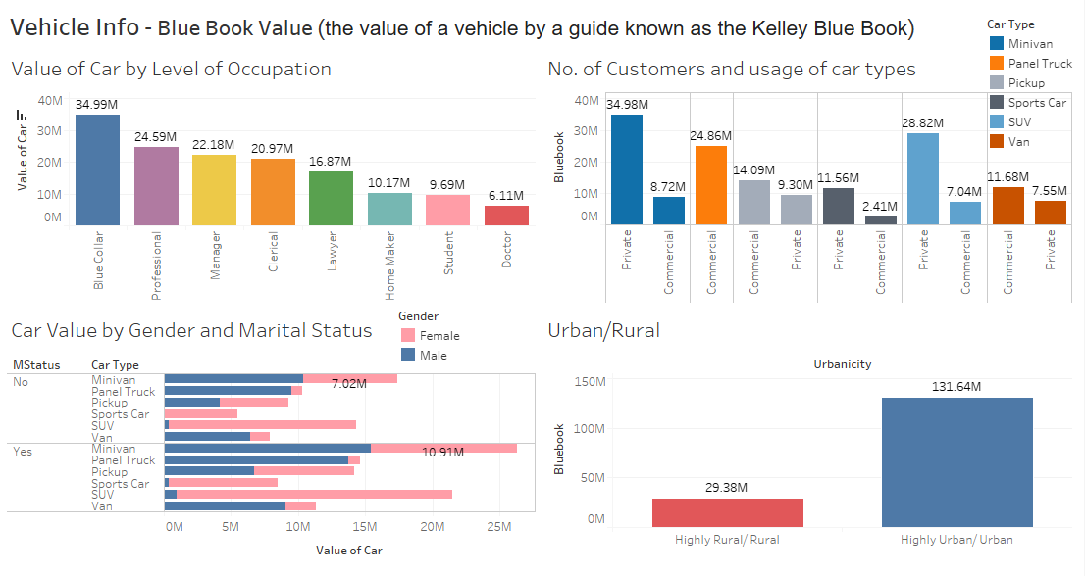
Vehicle Info Dashboard
Insight – Blue Collar have the highest car value among occupation, Minivan holds the maximum value among private car types and Panel truck among commercial, and sports cars holds minimum car value among both private and commercial. Minivan among married females have the maximum car value and Sports car among married male is the minimum. Highly-urban have the highest car value.

Slide 15
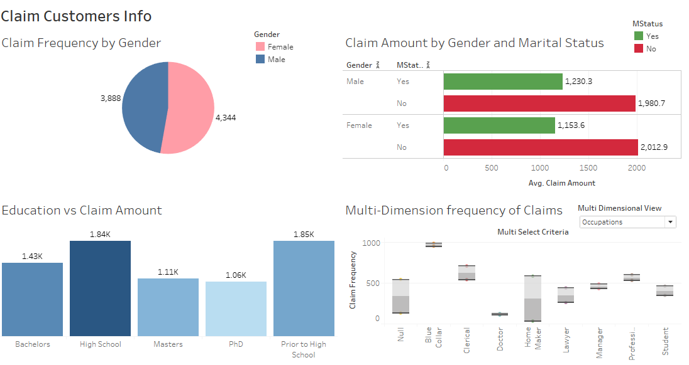
Claim-Customers Dashboard
Insight – Claim frequency is greater for females. Unmarried females have the highest average claim amount. Bachelors have the maximum average claim amount. Blue collar have the highest claim frequency.

Slide 16
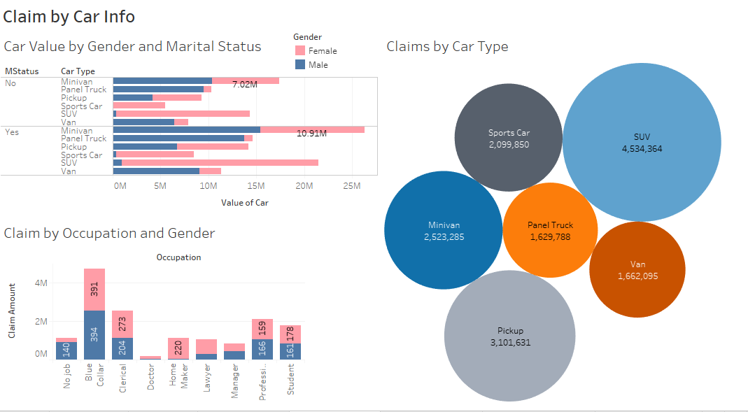
Claim by Car Info Dashboard
Insight – Frequency of unique claims is highest for SUV. Blue collar male have the highest unique claim frequency and highest claim amount.

Slide 17
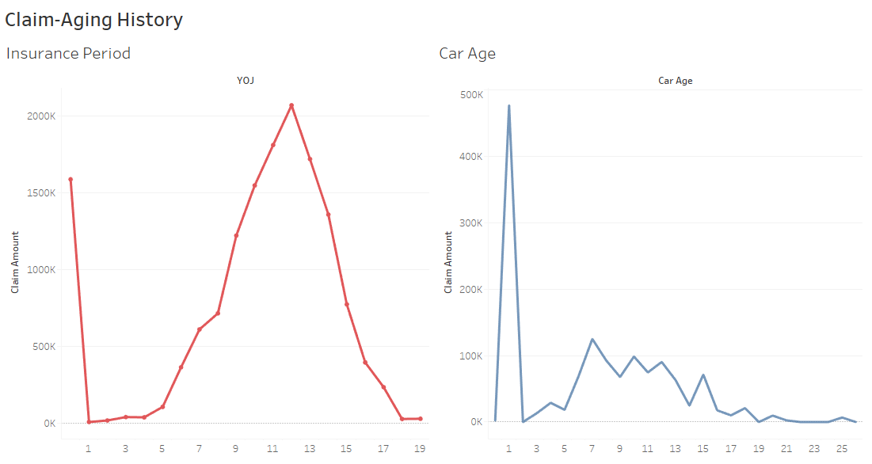
Claim-Aging History Dashboard
Insight- for YOJ- 12, we have the highest claim amount and for Car age 1 claim amount received is the highest.

Slide 18
Part -2
Predictive Analytics and Visualisation of Insights

Slide 19
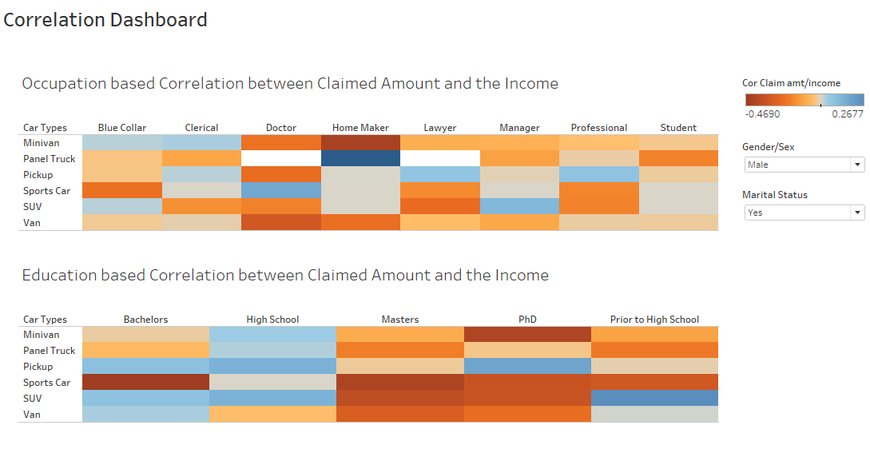
Correlation Dashboard
Insight – A female manager who owns a Panel truck having the highest correlation (0.895) between the claim amount and the income. Similarly a married male Doctor who owns a sports car have the highest correlation between income and the claim amount.

Slide 20
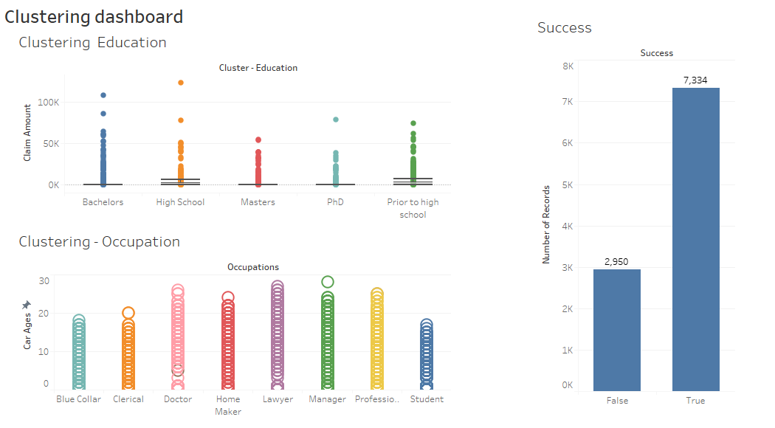
Clustering Dashboard
Insight – Clustering Education - The average Claim amount is 1512.16, but as we can see there is an outlier in Education- High school with a claim amount of 123.25K.
Success chart shows us that out of total of 10284, our cluster estimated 7334 correctly. Thus the accuracy of this cluster analysis is 71.31%.
.

Slide 21
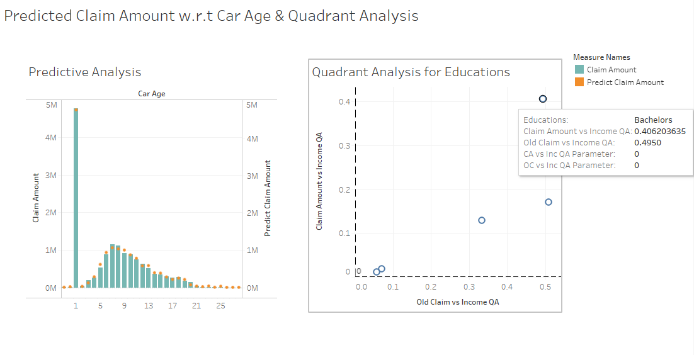
Predicted Claim & Quadrant Analysis
Insight- As we can see for bachelors, the correlation between the Claim amount vs Income is 0.40 and Old Claim vs Income is 0.49 and is the highest among all the education criteria.

Slide 22
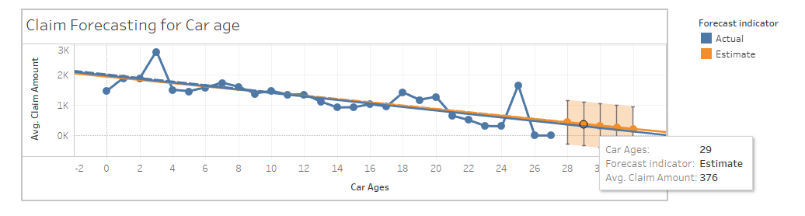
Claim Frequency Forecasting
With additive level, additive Trend and No Seasonality

Slide 23
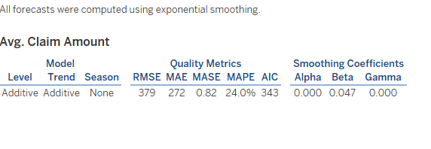
With additive level, additive Trend and No Seasonality
Insight - With additive level, additive Trend and No Seasonality, the average estimated claim amount at Age 29 is 376. The MAPE (mean absolute percentage Error is 24% and AIC is 343.). Thus the accuracy is 76.0%.
Insight - With additive level, additive Trend and No Seasonality, the average estimated claim amount at Age 29 is 376. The MAPE (mean absolute percentage Error) is 24% and AIC is 343. Thus the accuracy is 76.0%.

Slide 24
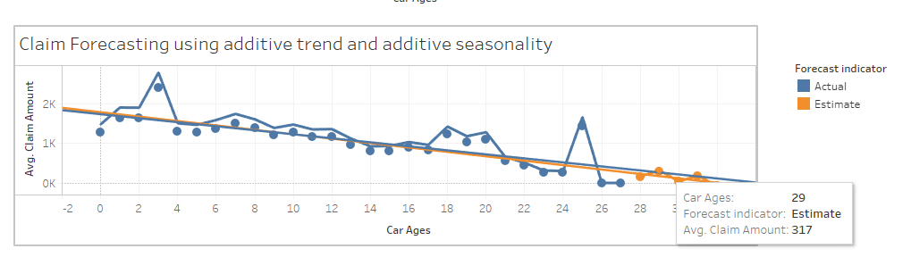
Claim Frequency Forecasting
With additive level, additive Trend and additive Seasonality

Slide 25
With additive level, additive Trend and additive Seasonality
Insight - With additive level, additive Trend and No Seasonality, the average estimated claim amount at Age 29 is 376. The MAPE (mean absolute percentage Error is 24% and AIC is 343.). Thus the accuracy is 76.0%.
Insight - With additive level, additive Trend and additive Seasonality, the average estimated claim amount at Age 29 is 317. The MAPE (mean absolute percentage Error) is 27.4% and AIC is 356. Thus the accuracy is 72.6%.

Slide 26
Conclusion –
We will consider the model with less MAPE and lower AIC value. Thus we will go for additive trend and no seasonality model which gives us the accuracy of 76.0%.

Slide 27

Thank you for Attention !

